Slide 1

Marijuana Arrests in Toronto:
Case Study:
Impact of Drug Policy on
Racial Disparities
A Statistical Analysis
DAT 200
Nov 2023
Mithun Manivannan

Slide 2
Breakdown
01
Dataset Context
02
Problem Statement/Objectives
03
Data Exploration
04
Statistical Analysis
05
Conclusions

Slide 3

Background Information:
Legal Context:
Marijuana possession was a criminal offense in Canada before 2018, leading to potential incarceration and criminal records for minor offenses.
The legalization of cannabis was partly aimed at rectifying the injustices caused by previous drug policies, which disproportionately affected marginalized groups.
- Prior to the legalization of cannabis in Canada in 2018, arrest records exhibit a stark overrepresentation of Black and Indigenous individuals in marijuana possession offenses.
- A University of Toronto study highlighted these disparities across major Canadian cities, including Toronto, despite similar self-reported rates of cannabis usage across different racial groups.
- Such disproportionate policing practices not only reflect systemic racial biases but also have long-term socioeconomic consequences for the affected communities.
Study Significance:
This study seeks to uncover the extent of racial disparities in marijuana arrests in Toronto and provide empirical data to support efforts toward more equitable law enforcement and criminal justice reforms.
The findings are expected to contribute to the national dialogue on racial equality, inform policy decisions, and guide practices toward decriminalization and restorative justice.
By scrutinizing the arrest patterns, the study underscores the necessity for further research into the impacts of drug policy on Canada's diverse population and the importance of ongoing monitoring post-legalization.

Slide 4
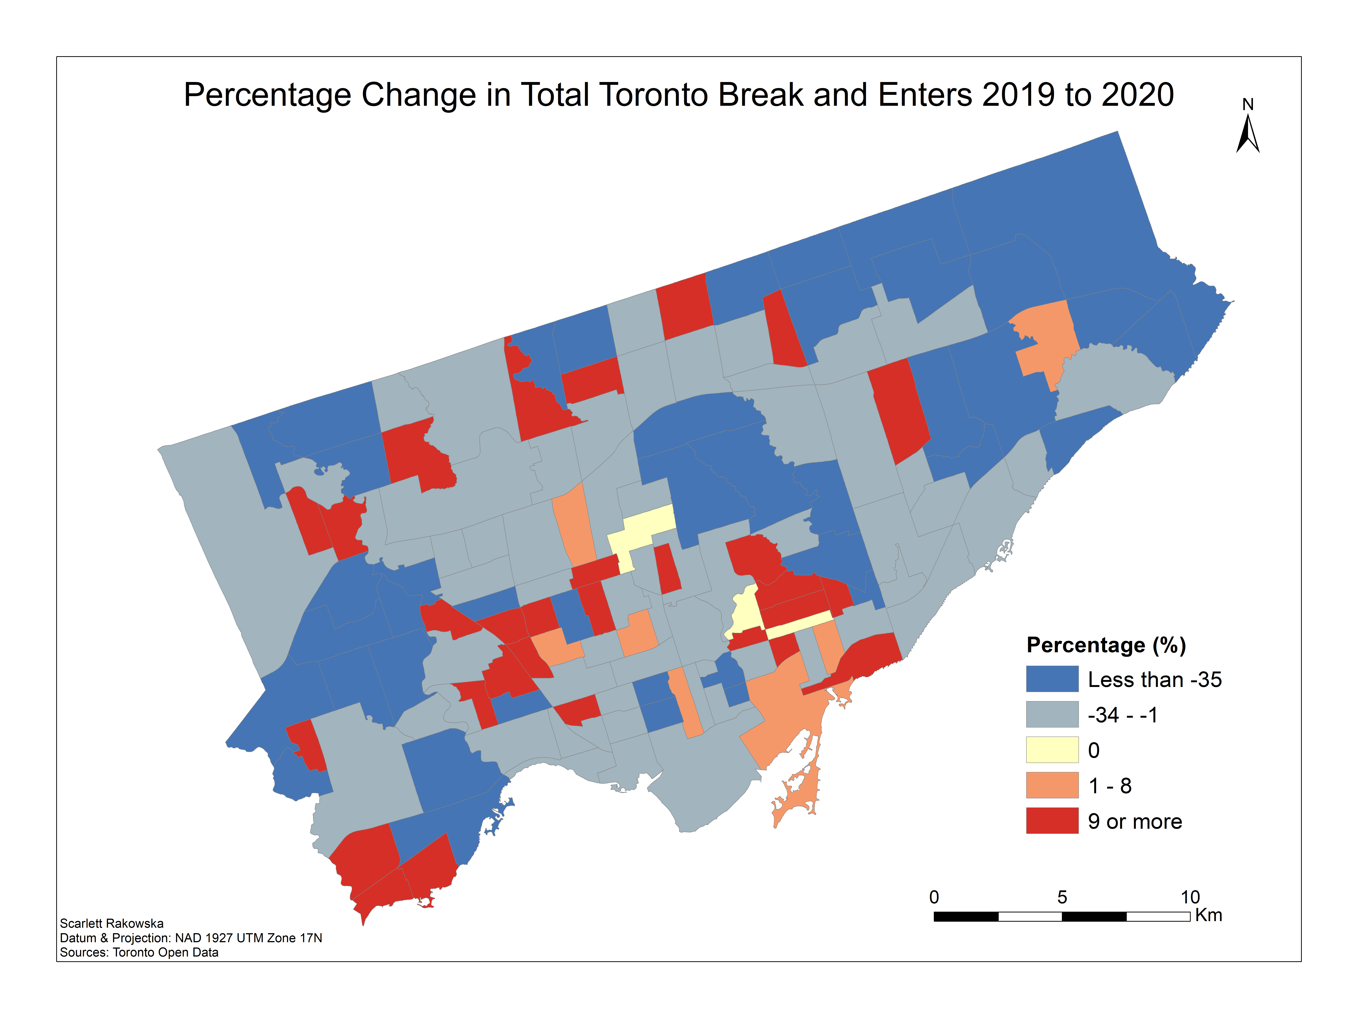

Dataset Background - Marijuana Arrests in Toronto
Summary:
What: Analysis of arrest records for simple possession of marijuana, highlighting racial disparities.
Period: Data covers years leading up to the legalization of marijuana in Canada.
Context:
Geography: Toronto, the largest city in Canada, known for its diverse population.
Socio-Political Climate: The city has been at the center of debates on marijuana policy, especially concerning its impact on different communities.
Dataset Characteristics:
Source: Toronto Police Service arrest records, supplemented with demographic data from Statistics Canada→ Kaggle Link
Content:
Variables: Arrestee race, age, gender, employment status, citizenship, number of police checks.
Data Type: Categorical and numerical.
Instances: 5226 observations from pre-legalization period.
Toronto Star Article

Slide 5
Problem Statement and Objectives
Problem Statement:
This analysis seeks to uncover racial disparities in marijuana arrest outcomes in Toronto. Given the implications of arrest records on individuals' futures, understanding these disparities is crucial for ensuring justice and equity within the legal system.
Case Study Objectives:
Objective 1: To quantify the extent of racial disparities in the release outcomes post-marijuana arrests.
Objective 2: To identify key factors that contribute to these disparities, such as employment status, age, and number of police checks.
Objective 3: To evaluate the predictive accuracy of a logistic regression model in forecasting release outcomes based on these factors.
Objective 4: To provide data-driven recommendations for policy reform and further research directions.

Slide 6
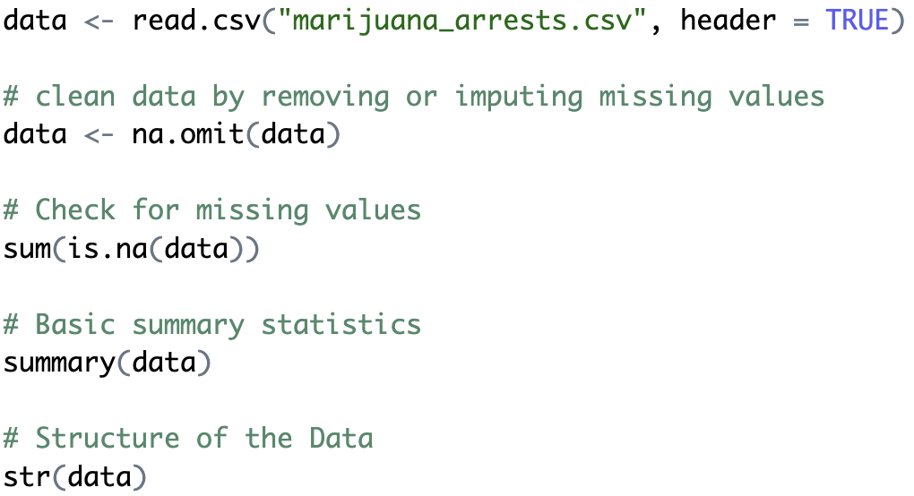
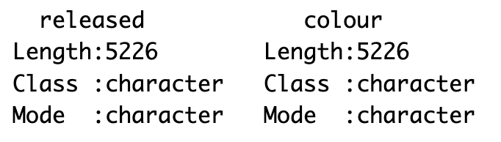
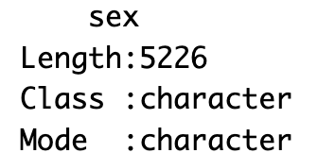
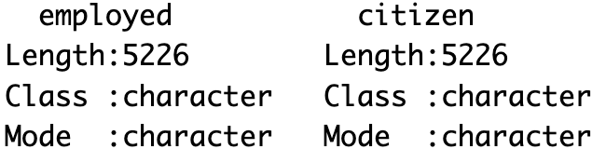
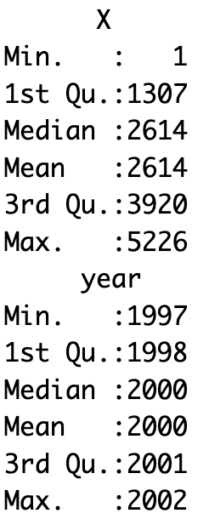
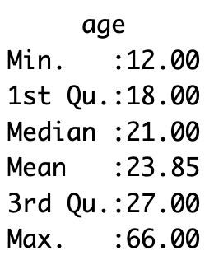
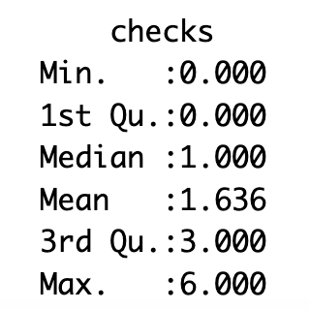
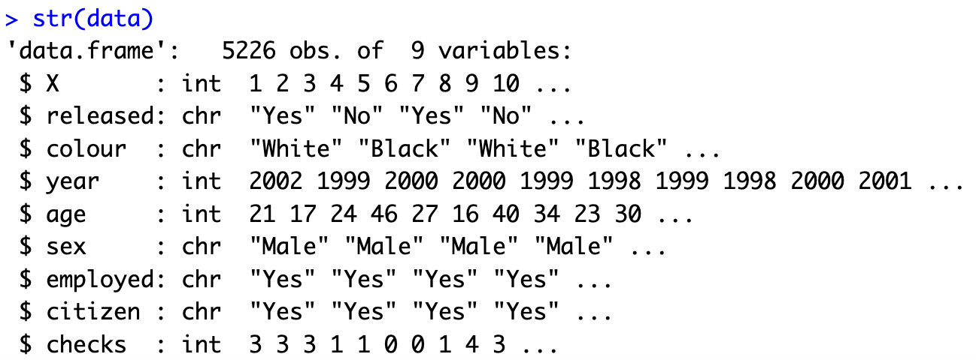
Dataset Exploration→ Initial Load + Summary Statistics
summary()
str()

Slide 7








Dataset Exploration→ Breakdown of Categorical Data
table()

Slide 8
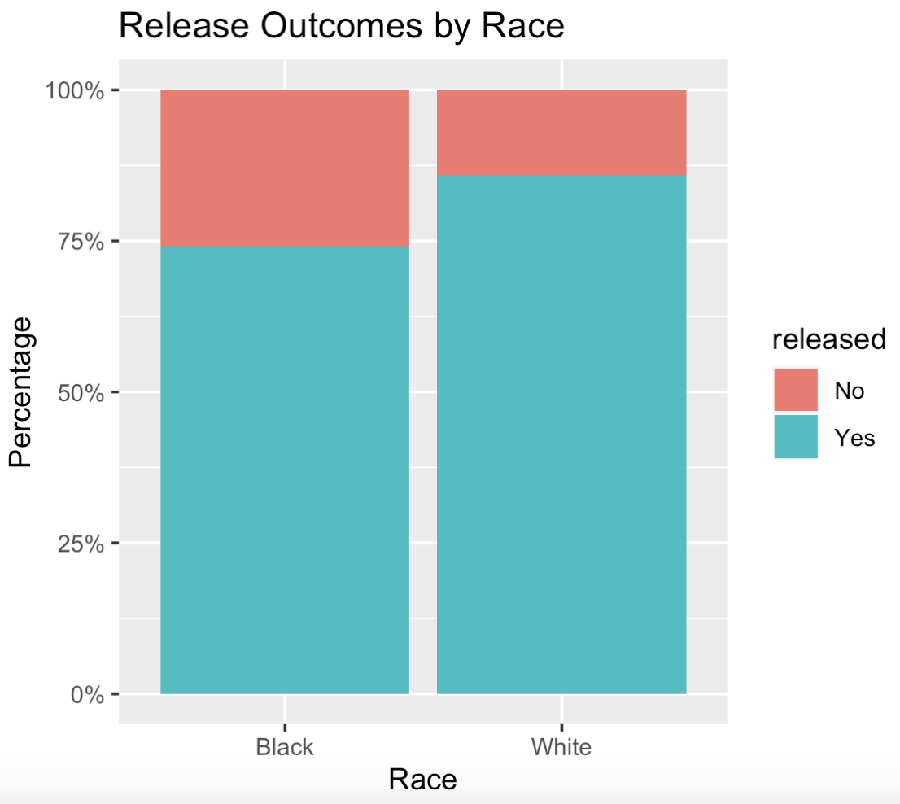
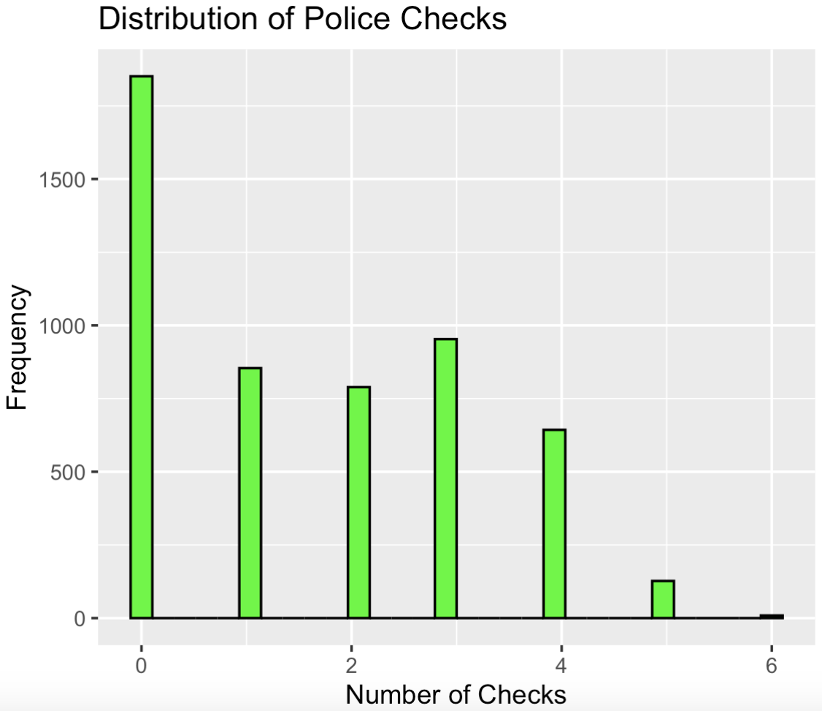
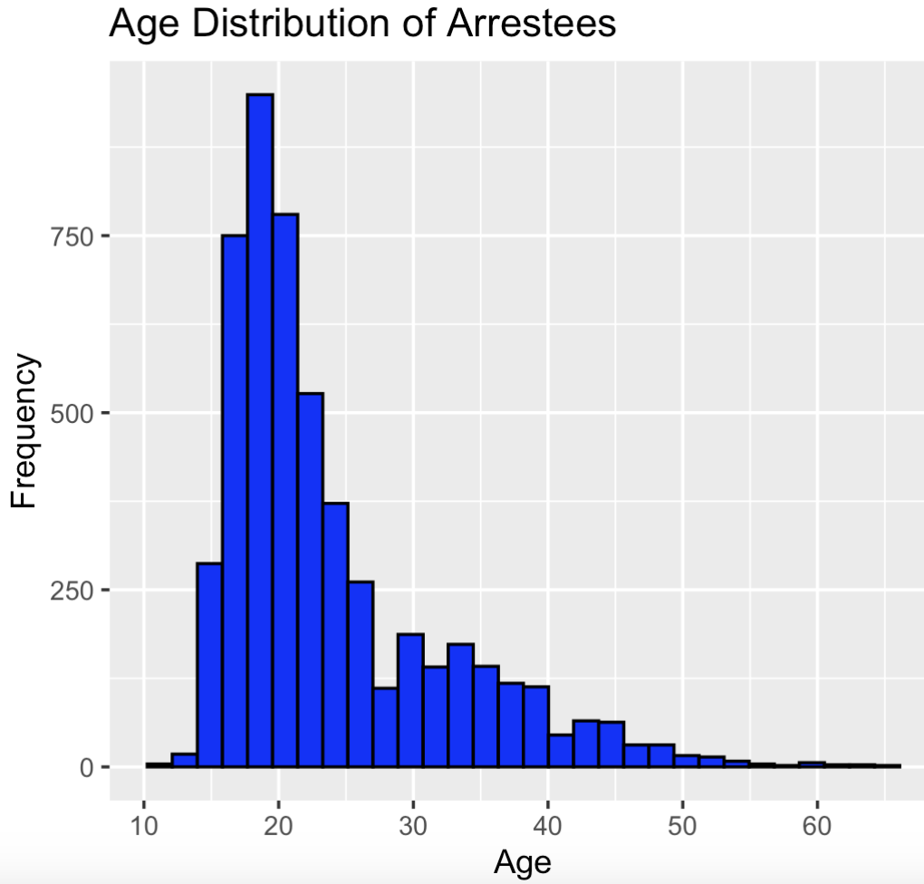
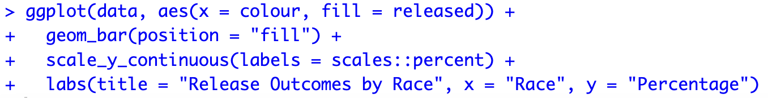
Dataset Exploration→ Exploratory Analysis
Release Outcomes by Race
ggplot() +
geom_histogram()
geom_bar()
Police Checks Distribution
Age Distribution of Arrestees

Slide 9
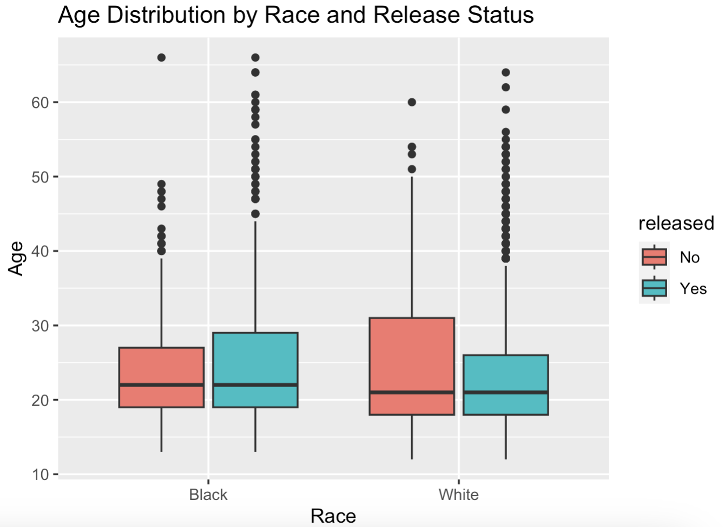
Dataset Exploration→ Exploratory Analysis
ggplot() +
geom_boxplot()
Central Tendency and Spread:
The median age of both Black and White individuals who are not released appears to be slightly lower than those who are released.
The age range (interquartile range) for Black individuals not released seems narrower compared to those released; this is less apparent for White individuals.
Outliers:
There are numerous outliers in all categories, indicating individuals who are significantly younger or older than the median age.
Race Comparison:
The age distributions for Black and White individuals in relation to their release status are similar, with no significant differences observable from the boxplots alone.
Release Status:
For both Black and White individuals, the boxplots for those who were not released tend to have a slightly lower median age than those who were released.
Boxplots for Age by Race and Release Status
**additional analysis could investigate if age is a significant predictor of release status when controlling for race and other factors.

Slide 10
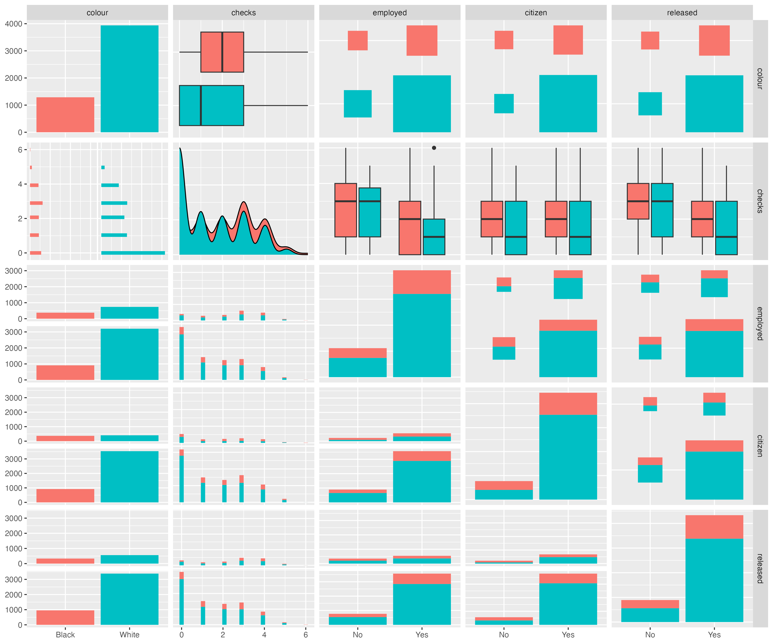
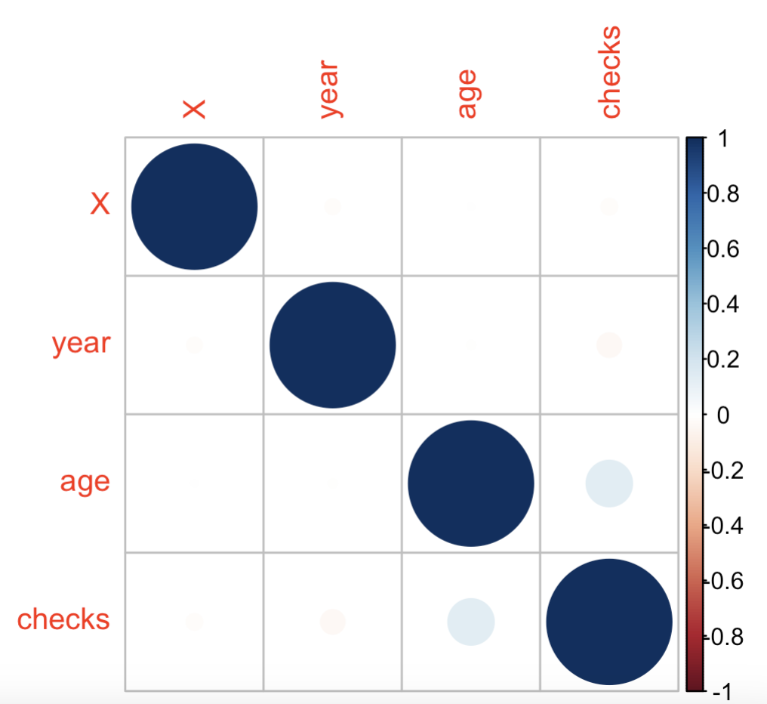
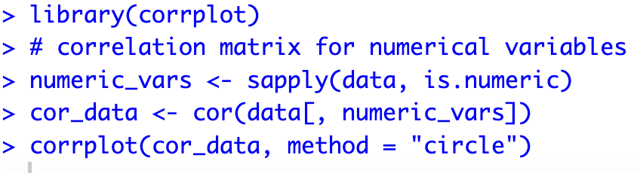
Dataset Exploration→ Pairwise Relationship + Correlation Matrix
ggpairs()
corrplot()
The correlations are generally very low, implying that there is no strong linear relationship between these variables. This might suggest that other factors not included in this set or non-linear relationships could be at play in the dataset.
Key Pairwise Relationships
& Correlations For
Numerical Variables

Slide 11
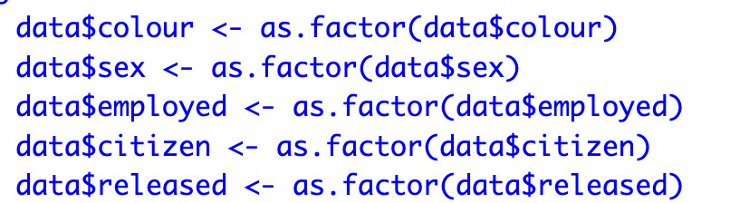
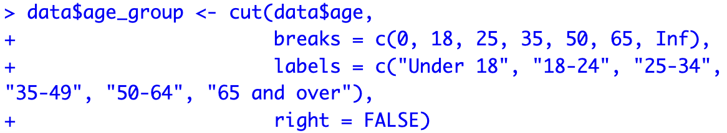
Variable Transformation
Transformations Applied:
Categorical Variables: Converted 'colour', 'sex', 'employed’,
'citizen’, and 'released' to factors to facilitate analysis.
Age Binning: Grouped 'age' into categorical age brackets to better understand distribution across different life stages.
The continuous nature of age can sometimes mask patterns in the data due to a wide range of values. Binning age into categories allows for a clearer analysis of trends and relationships within distinct age groups, facilitating interpretation and enabling the use of age as a categorical predictor in the logistic regression model, which can be particularly useful if the relationship between age and release outcomes is not linear.

Slide 12
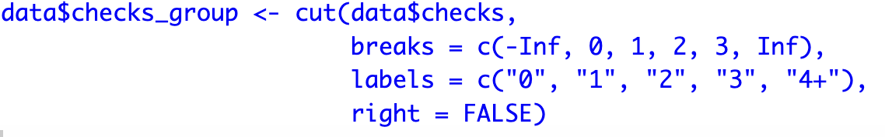
Feature Engineering
Police Checks Binning:
The number of police checks is a count variable, which may have a skewed distribution with many zeros. Grouping checks into bins helps to manage this skewness and can uncover trends across different levels of police interaction. It also reduces the impact of outliers by grouping infrequent, high counts of checks into broader categories.
Model Preparation:
Dummy Coding: When factor variables are used in a regression model, R automatically converts these into dummy variables. This allows for the inclusion of nominal categorical data in the model by creating binary (0/1) columns for each level of the factor, except one, which serves as the reference category. This process is essential for interpreting the effect of each category on the response variable.
Outcome Recoding: The outcome variable 'released' is recoded to ensure that it has exactly two levels, 'No' and 'Yes', which is a requirement for binary logistic regression. This recoding clarifies the interpretation of the model's coefficients, where 'Yes' can be understood as the probability of an arrestee being released and 'No' as not being released. The coding reflects the binary nature of the outcome and is necessary for the logistic regression model to appropriately assess the relationship between predictors and the release outcome.

Slide 13
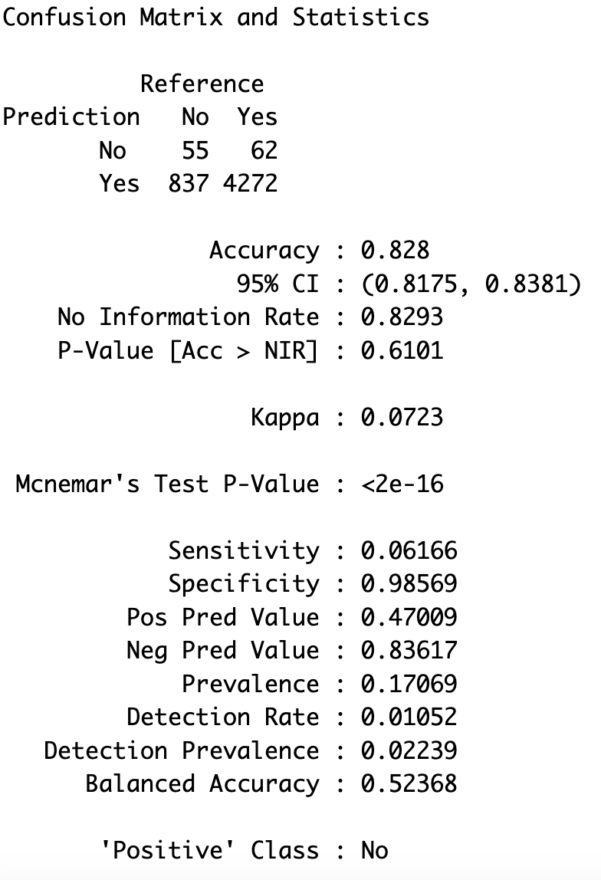
Evaluation of Logistic Regression Model
Model Overview:
Utilized logistic regression to predict the likelihood of release following a marijuana arrest.
The binary outcome variable 'released' was regressed against predictors including race, age, sex, employment status, citizenship, and police checks.
Confusion Matrix:
Performance Metrics:
Accuracy: Proportion of all predictions that were correct.
Sensitivity (Recall): Proportion of actual positive cases correctly identified.
Specificity: Proportion of actual negative cases correctly identified.
Precision: Proportion of positive identifications that were actually correct.

Slide 14
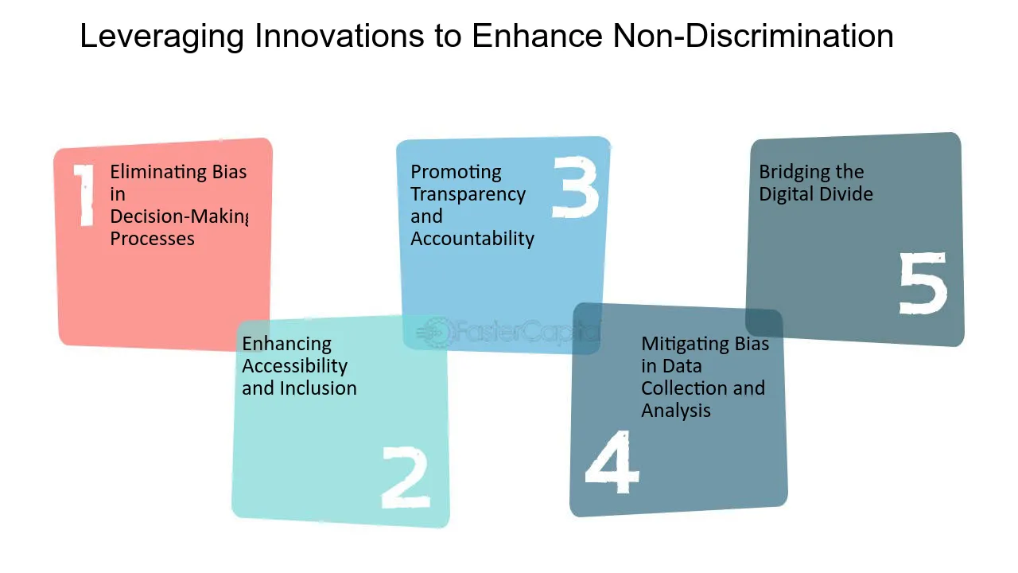
Evaluation of Logistic Regression Model
Implications for Future Policing: The model's findings underscore the need to address systemic biases reflected in arrest outcomes. The model's tendency to predict non-release could be reflective of an inherent bias in the arrest data or a cautious approach in the judiciary process. These insights should inform policymakers and judiciary reform advocates about the areas needing attention for fairer judicial outcomes. With low sensitivity, there's an imperative to review the factors contributing to the decision-making processes of law enforcement, ensuring they are not implicitly biased against certain racial groups.
Model Interpretations: The logistic regression model exhibits an accuracy of 82.8%, close to the No Information Rate of 82.93%, indicating that the model is only slightly better than random guessing. With a sensitivity of 6.166%, the model rarely identifies those who will not be released, which is concerning given the potential impact of wrongful detention.
However, its specificity is high at 98.569%, indicating it effectively identifies individuals who will be released. The balance between sensitivity and specificity is crucial, especially when considering the societal impacts of wrongful arrests based on racial profiling. False positives could lead to unnecessary legal consequences, while false negatives could undermine the justice system's integrity.
Policies must be informed by data-driven insights to mitigate disparities and foster fair policing practices. The model's insights could be a valuable tool for law enforcement agencies to reassess their arrest and release protocols, promoting transparency and accountability in their operations and rebuilding community trust.

Slide 15
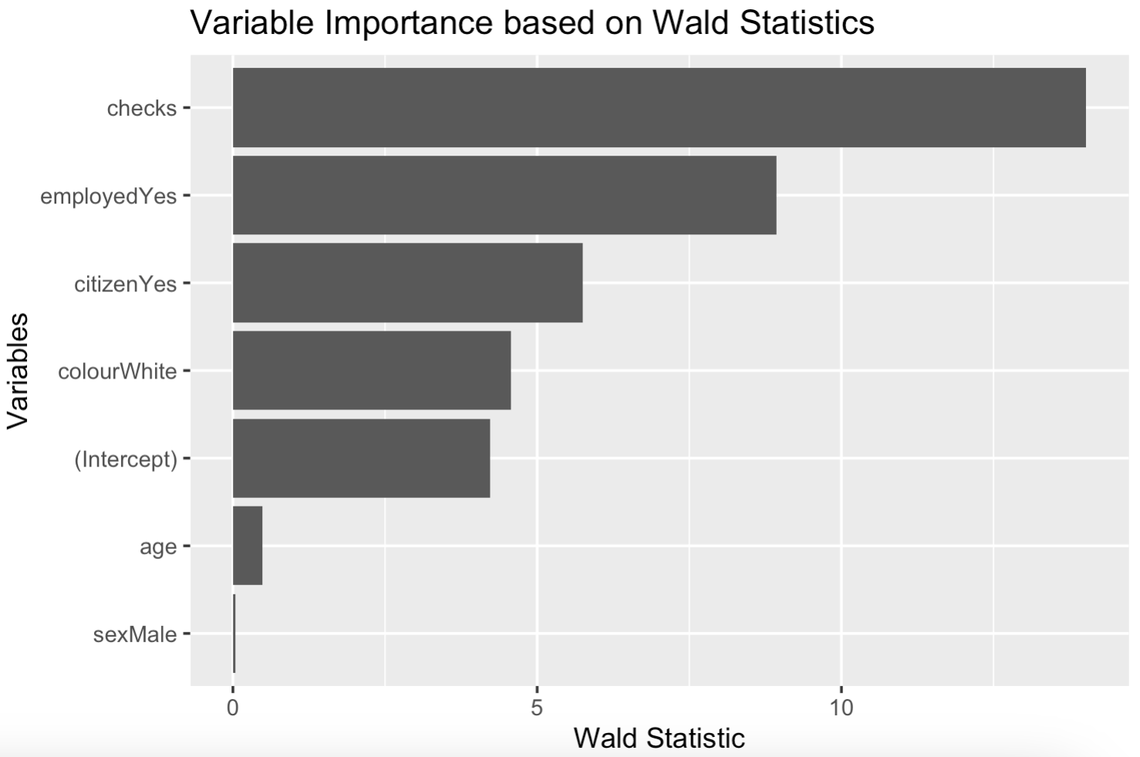
Assessing Variable Importance in Predicting Release Outcomes
Variable | Wald Statistic | Coefficient
checks | 14.025 | -0.363
employedYes | 8.936 | 0.757
citizenYes | 5.743 | 0.571
colourWhite | 4.571 | 0.390
(Intercept) | 4.220 | 0.940
age | 0.478 | 0.002
sexMale | 0.045 | 0.007
Wald statistics: Wald statistics, derived from logistic regression, measure the significance of each predictor variable in the model. It is computed by dividing the estimated coefficient by its standard error. The larger the Wald statistic, the more significant the variable.
Influence on Release Decision:
For instance, a higher number of police checks might reflect a bias in perceived recidivism risk, affecting release likelihood. Moreover, being employed or a citizen significantly increases the chances of release, possibly indicating systemic biases in the decision-making process. Understanding these influences can guide policy revisions and promote fairness in judicial proceedings."
Variables with higher Wald statistics, such as 'age' and 'number of checks', suggest a stronger relationship with the likelihood of being released post-arrest. These findings could indicate potential areas of bias or systemic issues within the release process.

Slide 16
Directions for Further Study
Deepening the Analysis:
To gain deeper insights into the factors affecting release outcomes, future studies could investigate the interaction effects between variables such as race and employment status.
Longitudinal Data Tracking:
Longitudinal studies would help understand the long-term impact of arrest on individuals' socioeconomic status, especially focusing on recidivism and rehabilitation outcomes.
Comparative Analysis:
Comparing these findings with post-legalization data could highlight changes in policing patterns and potential shifts in racial disparities.
Policy Impact Study:
Research into the effects of policy changes on arrest patterns and release outcomes could provide actionable insights for lawmakers.
Incorporating Additional Data:
Incorporating qualitative data from arrest reports and interviews with law enforcement could offer context to the quantitative findings and identify areas for procedural improvement.

